Slide 1
American History
1
Talk 20: Conquest of the West (1860-1900)
Part Two

Slide 2
“Wild West” 1865-1880

Slide 3
Mass Migration
 | 1860 | 1880
Nebraska | 28,000 | 450,000
Kansas | 107,000 | 950,000
Iowa | 670,000 | 1,600,000
South & North Dakota | 4,000 | 120,000
Texas | 600,000 | 1,600,000
Absence of formal structures of governance
…land claims
…cattle ownership
…legal system
…large male population accustomed to violence…esp “Border Wars”

Slide 4
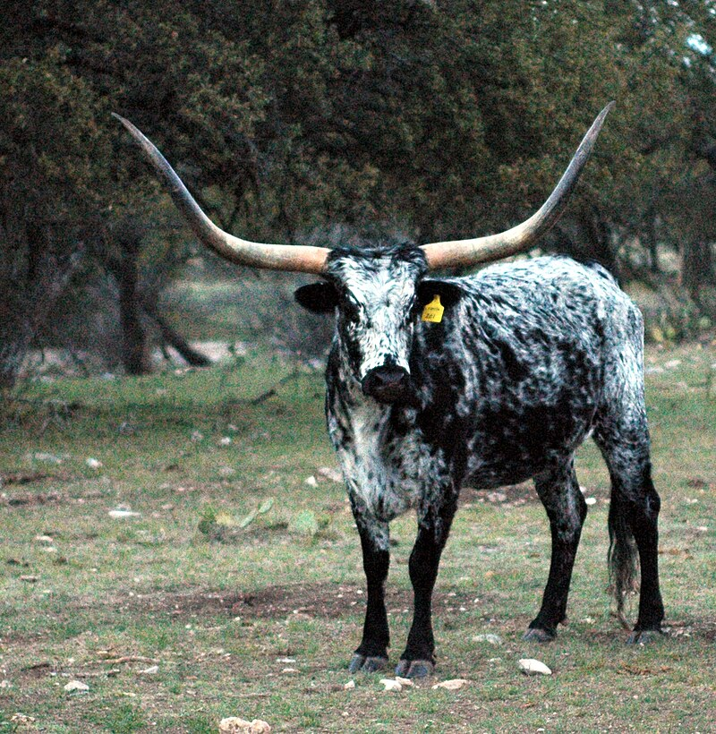
Longhorn Cattle
Introduced to Americas by Spanish in Mexico in 1500’s…hardy, heat,
…undeveloped
…turn feral
Open Range ranching develops
1800’s across Texas .first cattle drives 1850’s to California after gold rush. Then to supply South
Ranches abandoned ..farmer
Join war price of cattle to $2 head
…abandoned as North blocks Mississippi
…250,000 wild cattle in Texas plains
Post civil war……opportunity
Trans continental railroad
Meat Packing industry Chicago
Indian reservations ready market…collapse of buffalo

Slide 5
Cowboys
Profile
25% black
Immigrants, Mexicans, Native Indians…many Irish, English
Young men, short in stature
Work
Rounding up cattle from open range
Branding of cattle
Driving herds to Texas
$25- $40 per month salary…paid at end of drive
Spent fast…clothes, drink, women
James Cook… 50 years on the old frontier: “We were each allowed to take a pair of bed blankets
and a sack containing a little Extra clothing. ..We had no tents or shelter of any sort other than our
blankets. No provision was made for the care of men in case of accident. Should anyone become
Injured, wounded or sick, he we be strictly ‘out of luck’…

Slide 6
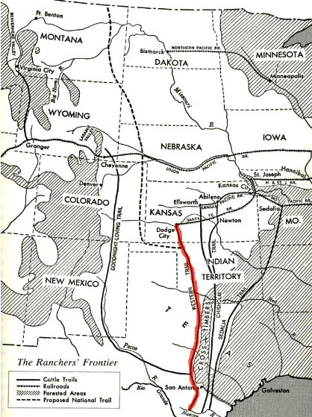
Cattle Drives
2,000 -3,000 cattle
10 cowboys, 10 miles/day
2-3 months 24 hours day
…$20 per day wages
From Texas to Dodge City
Loaded by train to Chicago
for slaughter, first for Indians
Then east coast….first
Refrigerated railcar 1868
Several rivers to cross
Biggest danger stampede
Disease, accidents,
..few Indian attacks

Slide 7
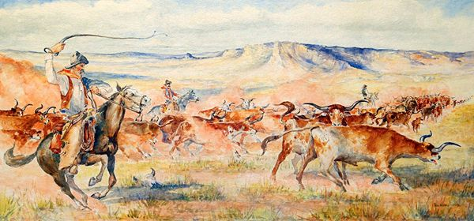
Cattle Drives

Slide 8
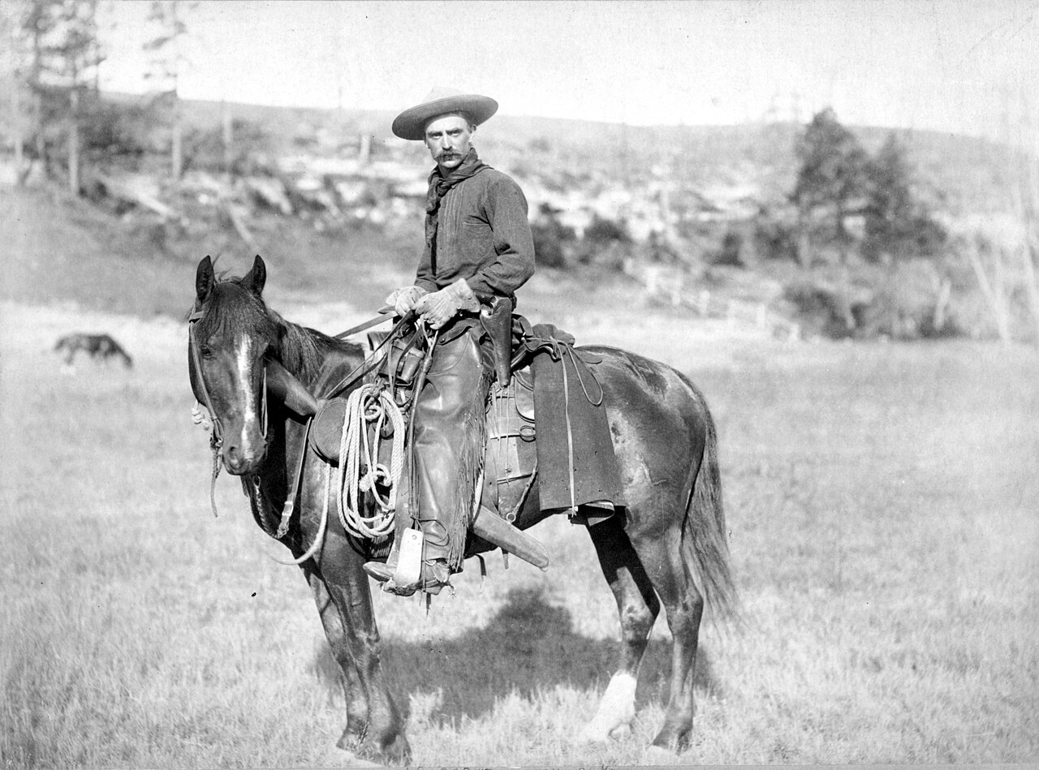
Cowboy with full kit 1880

Slide 9
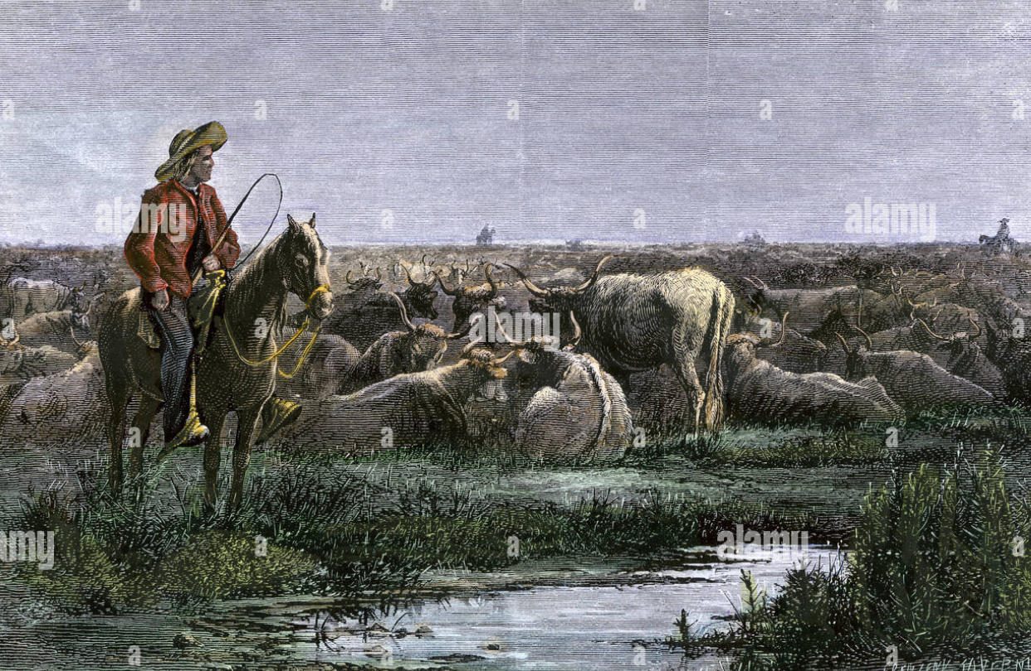
Cowboys and night

Slide 10
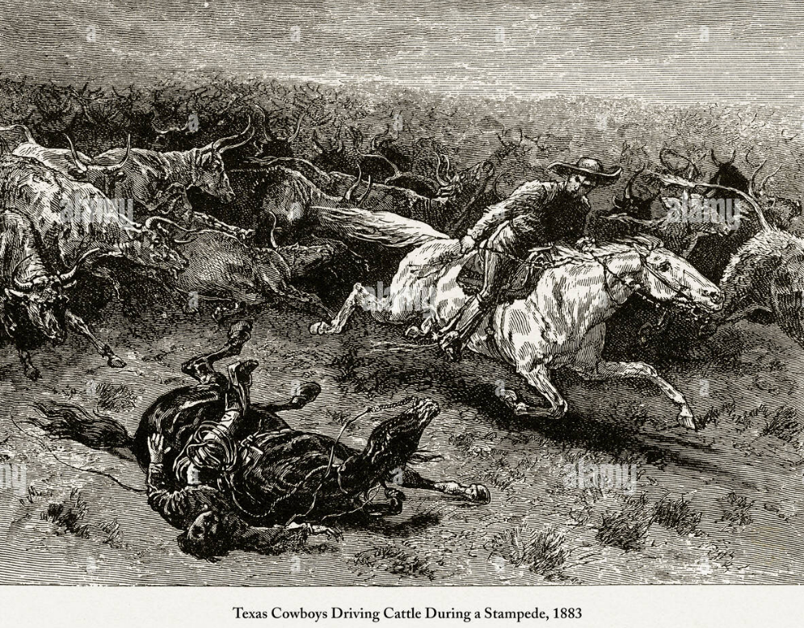
Stampede

Slide 11
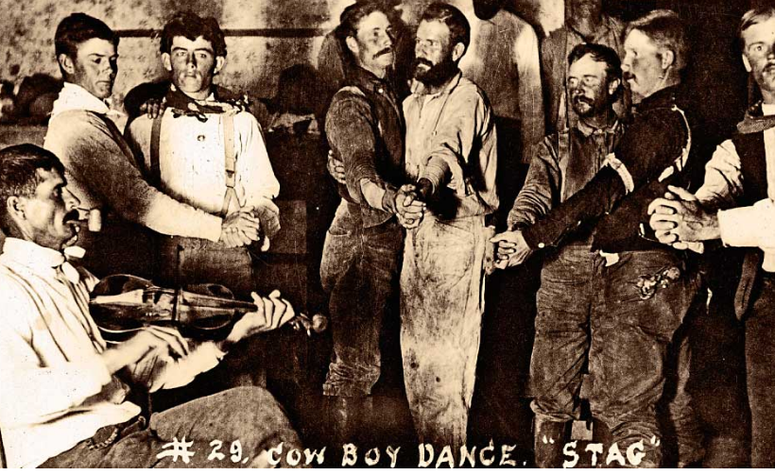
Having fun

Slide 12
Settler “Explosion” post Civil War
Economic depression 1873…move west for new life
Homestead Act 1862 …160 acres of free land for any male
Demobilised soldiers in need of work, accustomed to violence
Freed slaves
Immigrants from Germany, Poland, Sweden
Mining Boom….more miners than cowboys by 1880
Silver & Gold Nevada
Copper Arizona
Gold Dakotas
Boosterism
Popular magazines
“Weather follows the plough”!

Slide 13
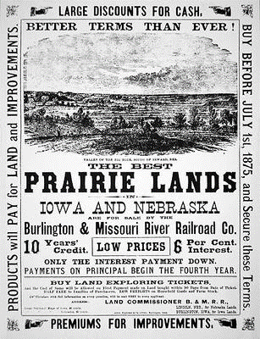
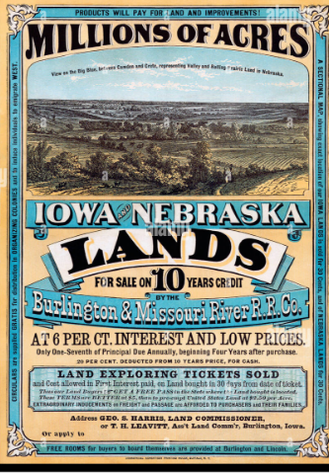
Marketing the West

Slide 14
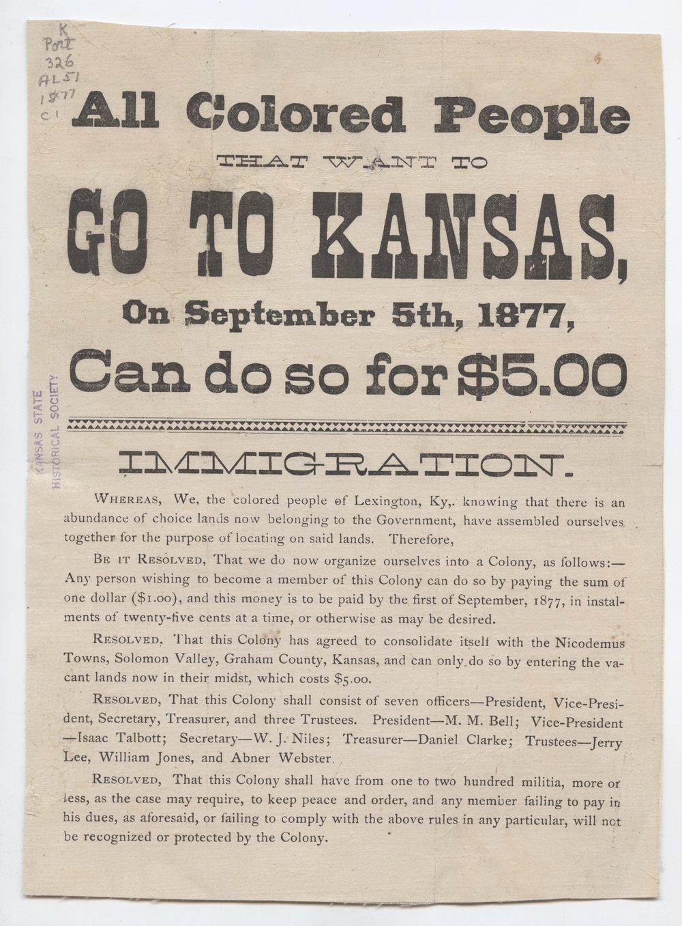
Advertising land for newly freed slaves

Slide 15
“Weather follows the plough”
“Great American Desert” ---idea of West 18th –early 19th century
1870’s unusual wet period Great Plains
Enter the politicians….geologists1870’s …unusual
Charles Wiber “God speed the plow. ... By this wonderful provision, which is only man's mastery over nature, the clouds are dispensing copious rains ... [the plow] is the instrument which separates civilization from savagery; and converts a desert into a farm or garden. ... To be more concise, Rain follows the plow.[1]
US Geology Department….vibrations of ploughs disturbs earth releasing chemicals that caused cloud formations

Slide 16
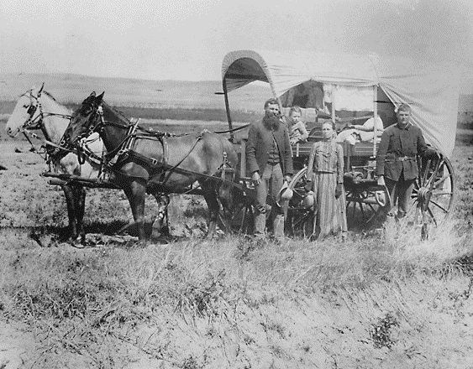
Homesteaders

Slide 17
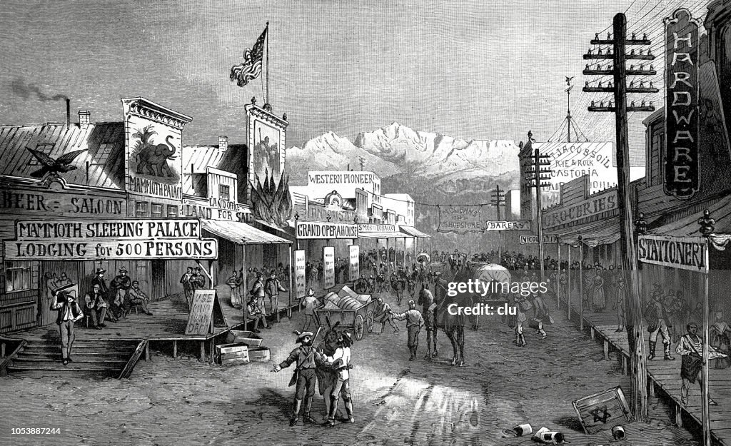
Instant Cities
Trailheads/ Rail hubs
…Abilene
…Dodge city
Mining towns
….appear
.then disappear
..’ghost towns’

Slide 18
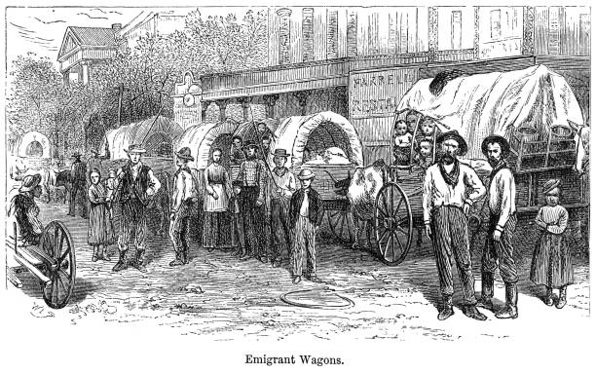
Wagon Trains……assembling at “rail heads closer to settlement as trains expand

Slide 19
River side saloon

Slide 20
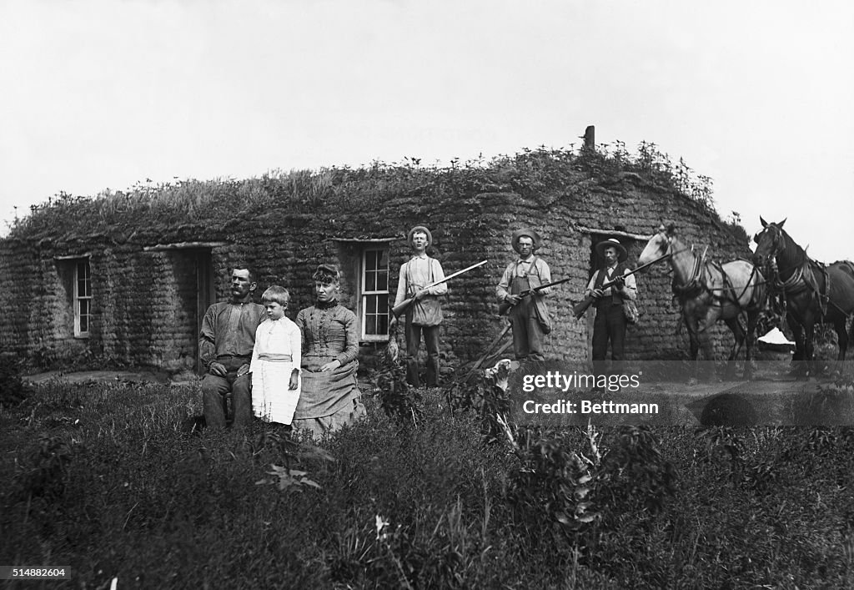
Isolated, dangerous, fleas, flies, hot and usually boring….but home

Slide 21
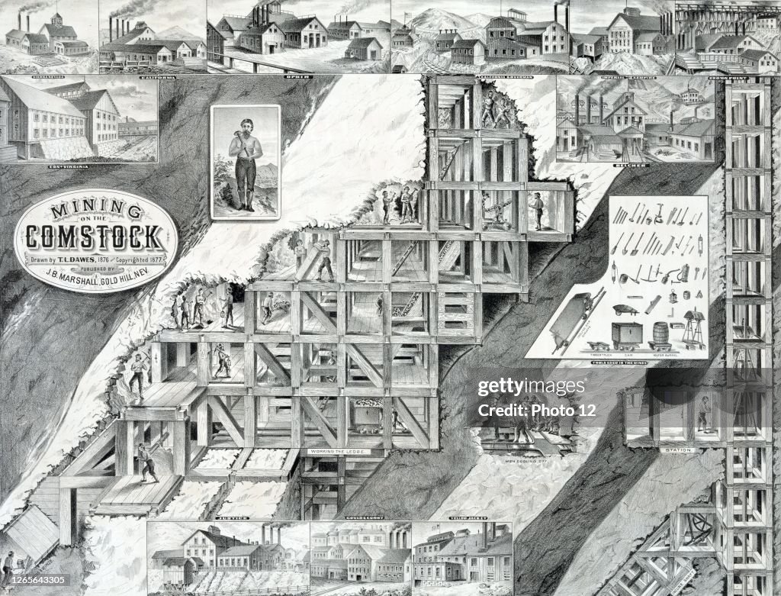
Comstock Lode, Nevada
Silver discovered
1859…..rush to
Seize land….new
Cities
Gold seams
Found 1874
Peak production
1874 $500m Silver
$600m Gold (2020 $)
400 independent
Mining company
10,000 miners
…many similar
‘Bonanzas”

Slide 22
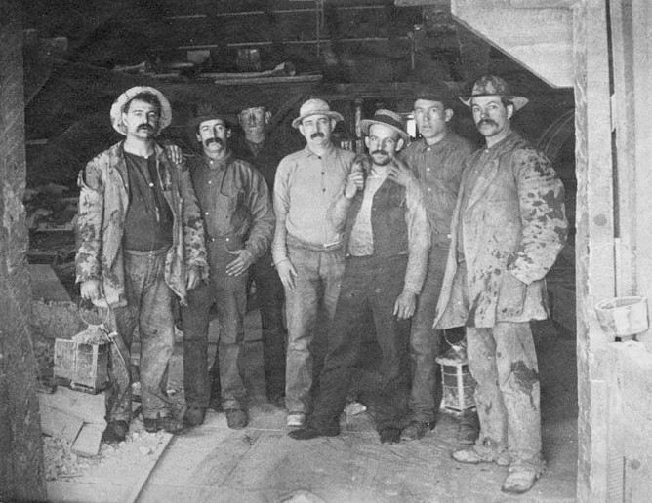
Miners….Comstock Lode 1880

Slide 23
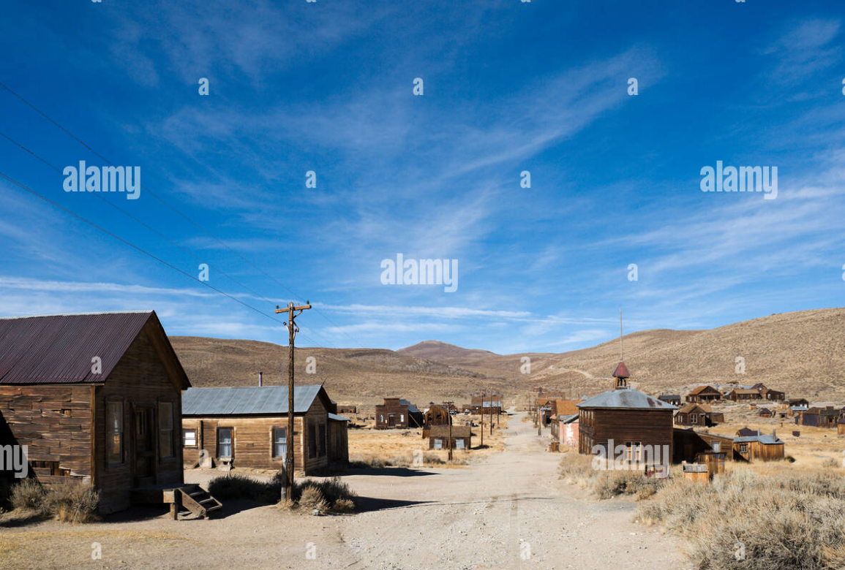
Ghost town….Nevada silver mine

Slide 24
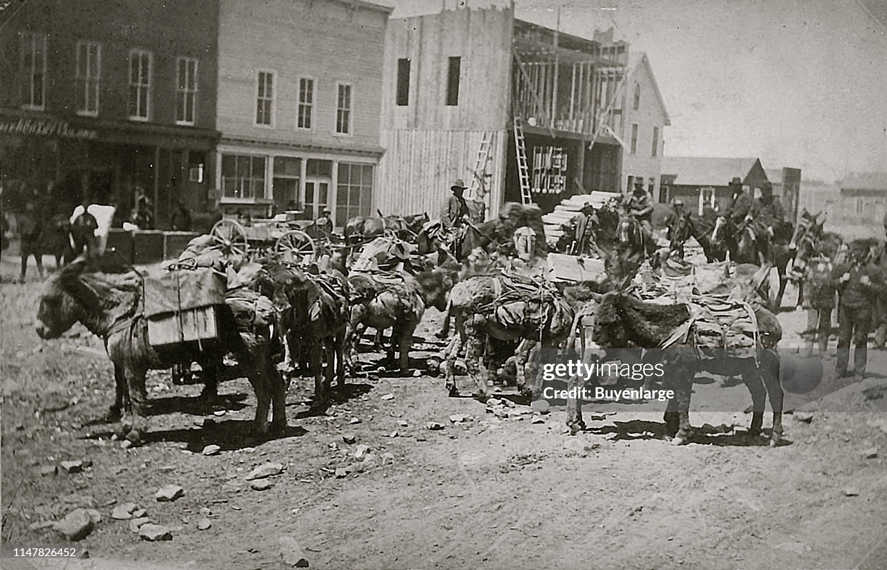
Mining town…loading pack mules

Slide 25
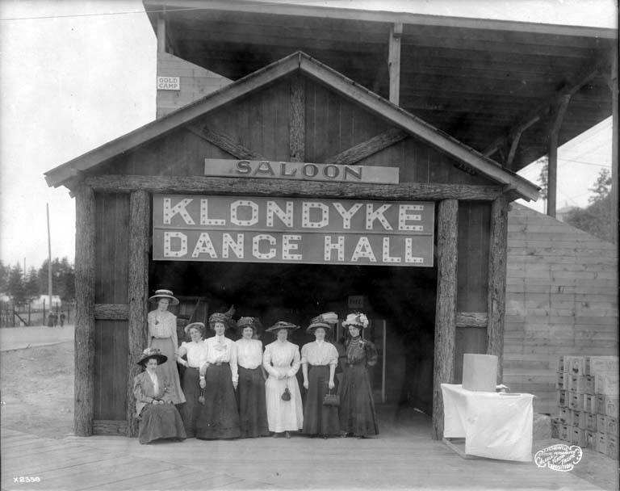
Ladies at the dance hall

Slide 26
Outlaws

Slide 27
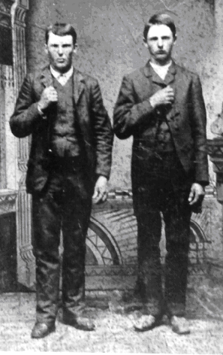
Jesse and Frank James
From Missouri, teenagers join
Bloody Bill Anderson during Civil war…Centralia Massacre Murdered 22 unarmed soldiers, 100 prisoners
Jessie
Frank
Missouri Reconstruction no jobs,
Career in bank robbing….form
James gang rob trains…celebrities
During 1870’s...protected by ex Confederates .Trains hire Pinkerton detective.. reward by train companies…not government
Northfield raid…disaster..towns people fight back f
Jesse hides with sister murdered hanging
Pictures…killer becomes celebrity
Frank surrenders, pardoned, becomes
Avid gardener, shoe salesman, silent
Movies, tour guide. Dies peacefully
1915

Slide 28
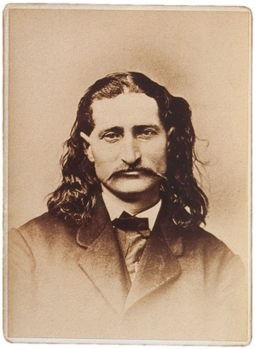
Wild Bill Hickok (1837-1876)
Illinois born….’Jayhawker” in Missouri
joins North in Civil war…scout, spy
Post war career as scout for army
Indian wars, gambler, Horse rustler,
7 duels. Wins all. Elected sheriff
Newspapers boost him as celebrity
…failed career as travelling
Circus performer with hired Indians
…disobedient buffalo
Returns to west…career in
Gambling
..ups and downs
….murdered while playing poker

Slide 29
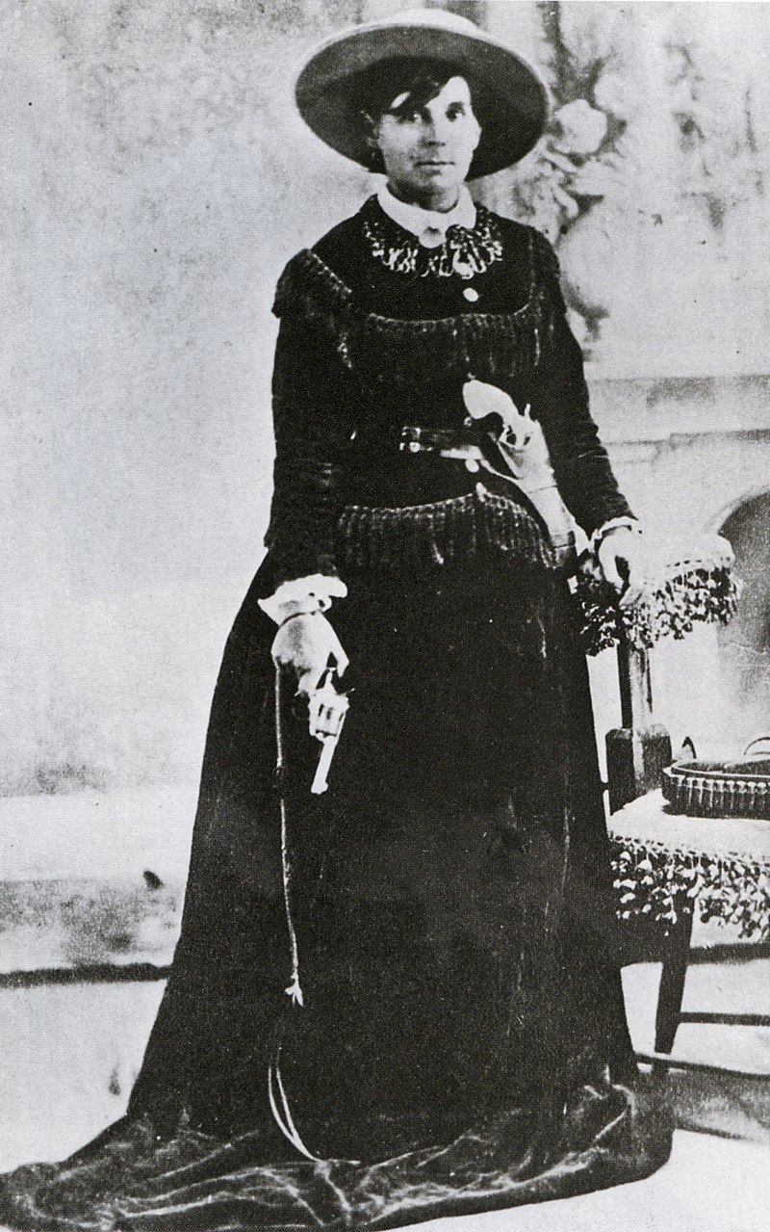
Belle Star (1848- 1889)
Classically educated
Missouri…family “low class”
..not slave owners.
Brother joins “bushwhackers”
Belle spy, brother killed. Family
To Texas. Marries James Reed
..bank robber. Belle helps out
“crack shot, rode side saddle
Velvet hat”…Reed killed
Joins “James gang”….marries
Cherokee Sam Starr. Horse stealing..9 month
..model prisoner. Leaves. Sam
Killed in gunfight..2 children..
One gunfighter killed, daughter
Prostitute. Brothel owner
Belle…murdered after refusing
Man a dance 1889

Slide 30
End of the Frontier

Slide 31
End of the Frontier 1880’s -1890’s
Buffalo extinction
End of Indian Wars
Ranching industry
Transition to state hood and governance
Agriculture depression

Slide 32
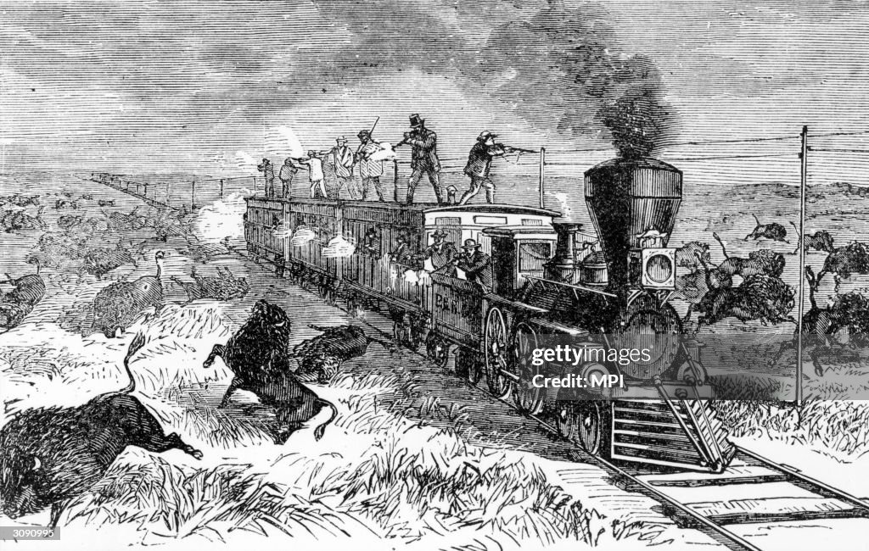
Industrialised buffalo hunting

Slide 33
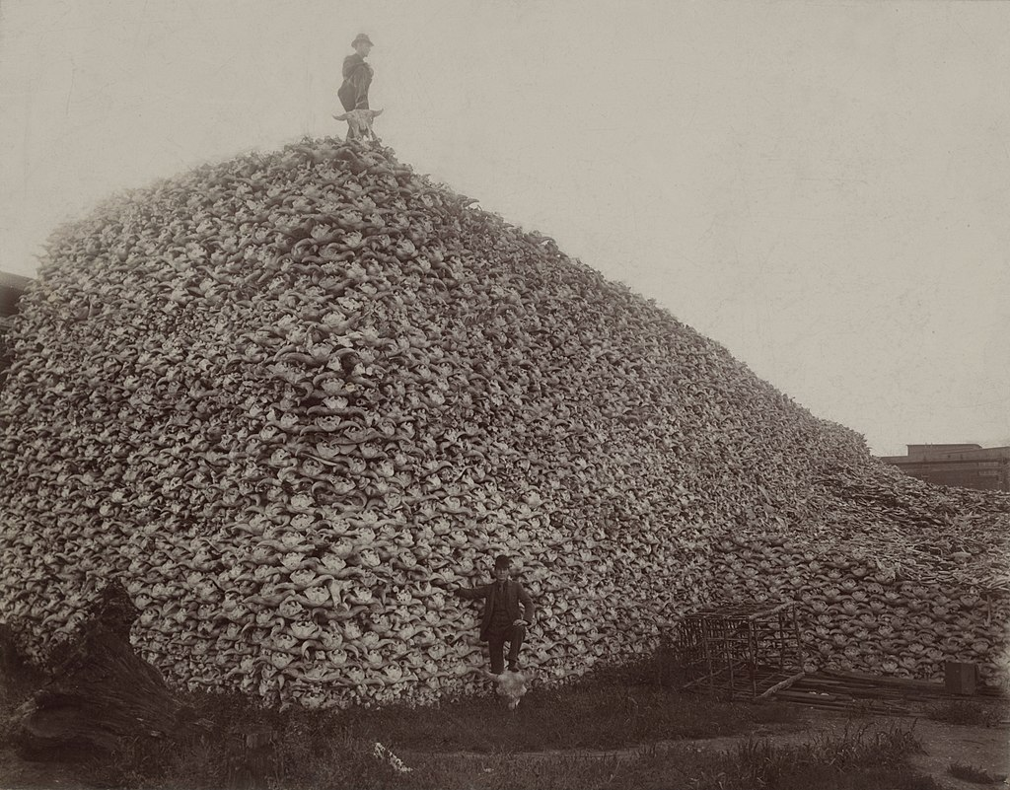
Elimination of the buffalo
Commercial buffalo hunters
Kill 200/ day…used for hides
Glue $3 hide…..expand to
Indian reservations…Indians
Kill hunters…US army decides
To exterminate herds….
Conservations complain
Pres Grant vetoes preservation
Memoir buffalo hunter Frank Meyer “We…served our purpose In helping abolish the buffalo …or maybe I’m just rationalising . Maybe we were just a greedy lot who wanted to get ours and to hell with posterity. Just so we kept ..our money Pouches filled. I think that is way It was”

Slide 34
Wounded Knee 1890
Lakota Sioux living in reservations
Starving
Culture obliterated
Shock of buffalo disappearance
Lakota Sioux mystic Wovoka launches Ghost Dance movement
Dance will invoke flood to drown the whites
Bring buffalo back to life
Jesus has returned and will come to lead Indians as “Great Chief”
US Army considers dance dangerous
600 men with new machine guns surround camp
Demand Indians hand in weapons
Indians resist and mowed down….300 killed (18 soldiers)

Slide 35
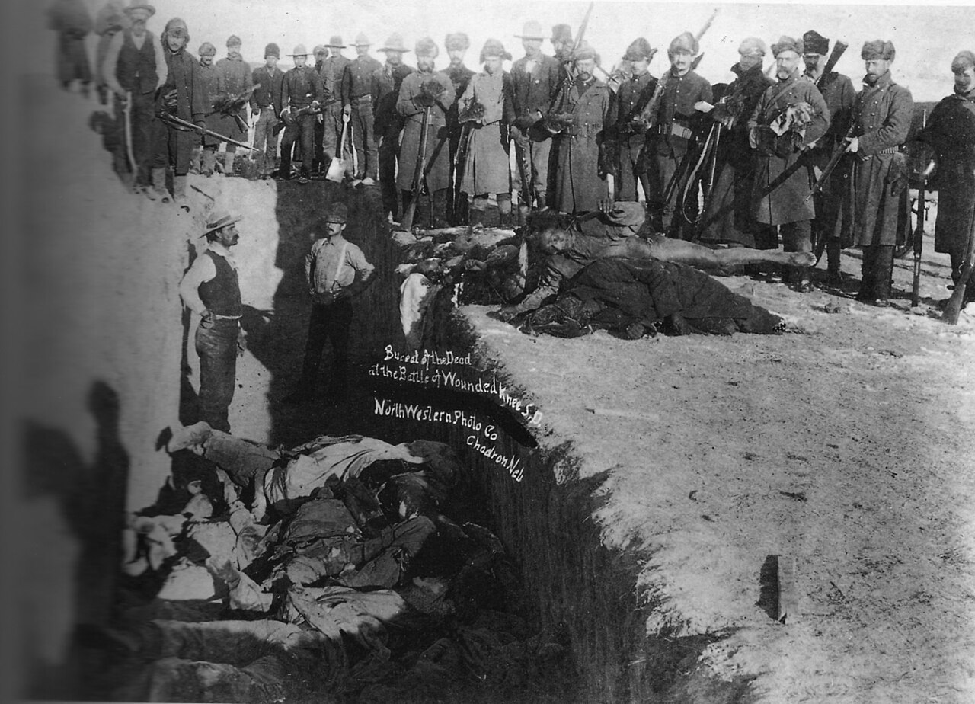
Wounded Knee aftermath 1890

Slide 36
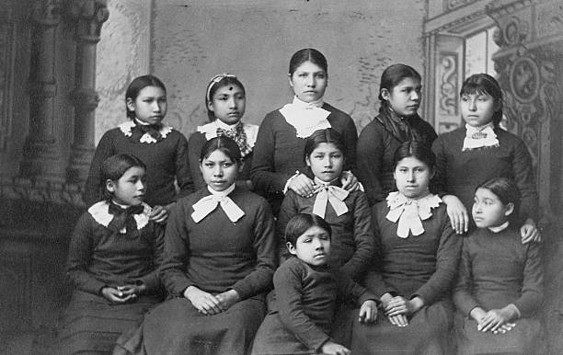
Girls Boarding School 1890’s

Slide 37
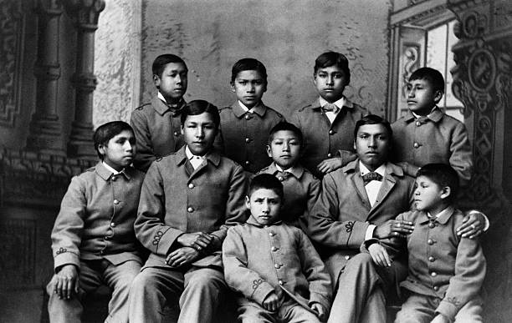
Boy’s Boarding School

Slide 38
End of the cowboys
Expansion of railroads and invention of refrigeration
Increased competition for land
Farmers vs Cowboys
Rangers vs cowboy wars
Range wars 1880; 90’s…small scale, violent, employment of ‘assassins”
Land enclosure
Barbed wire….invented 1867….improved 1870’s… pervasive 1880s
Promoted aggressively “it takes no room, exhausts no soil, shades no vegetation, is proof against high winds, makes no snowdrifts, and is both durable and cheap!
Weather change….”great die up” 1886/87…end of “open range”
Cowboys redeployed as ranch hands, farmers, miners or move to newly emerging cities

Slide 39
Agriculture 1880- 1890’s
Falling price of wheat 1870 - due to Chronic Overproduction
Settlers continue arriving in vast numbers
2 million farms 1870, 10 million 1900…Germans and Swedes
Increase automation and adoption of mono culture (wheat)
Failure of cooperative movements Granger movement fails
Granger Movement established 1867, 5 million members 1870’s…focus education, includes equal membership for women
Grangers dominate farming states…impose pricing restrictions for railroads. warehouses….over ruled by Supreme Court
Establish Cooperative ventures….storage, farm machinery, all fail
Changes in weather
”Wet years” end 1890..drought till late 1900
Lots too small …survival requires irrigation…requires capital

Slide 40
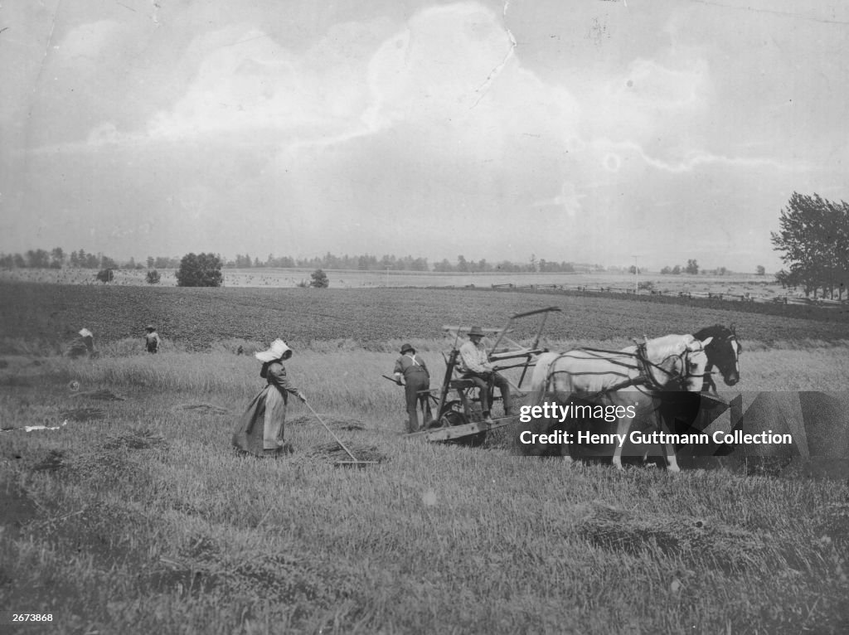
Farming in the Dakotas….horse drawn reapers

Slide 41
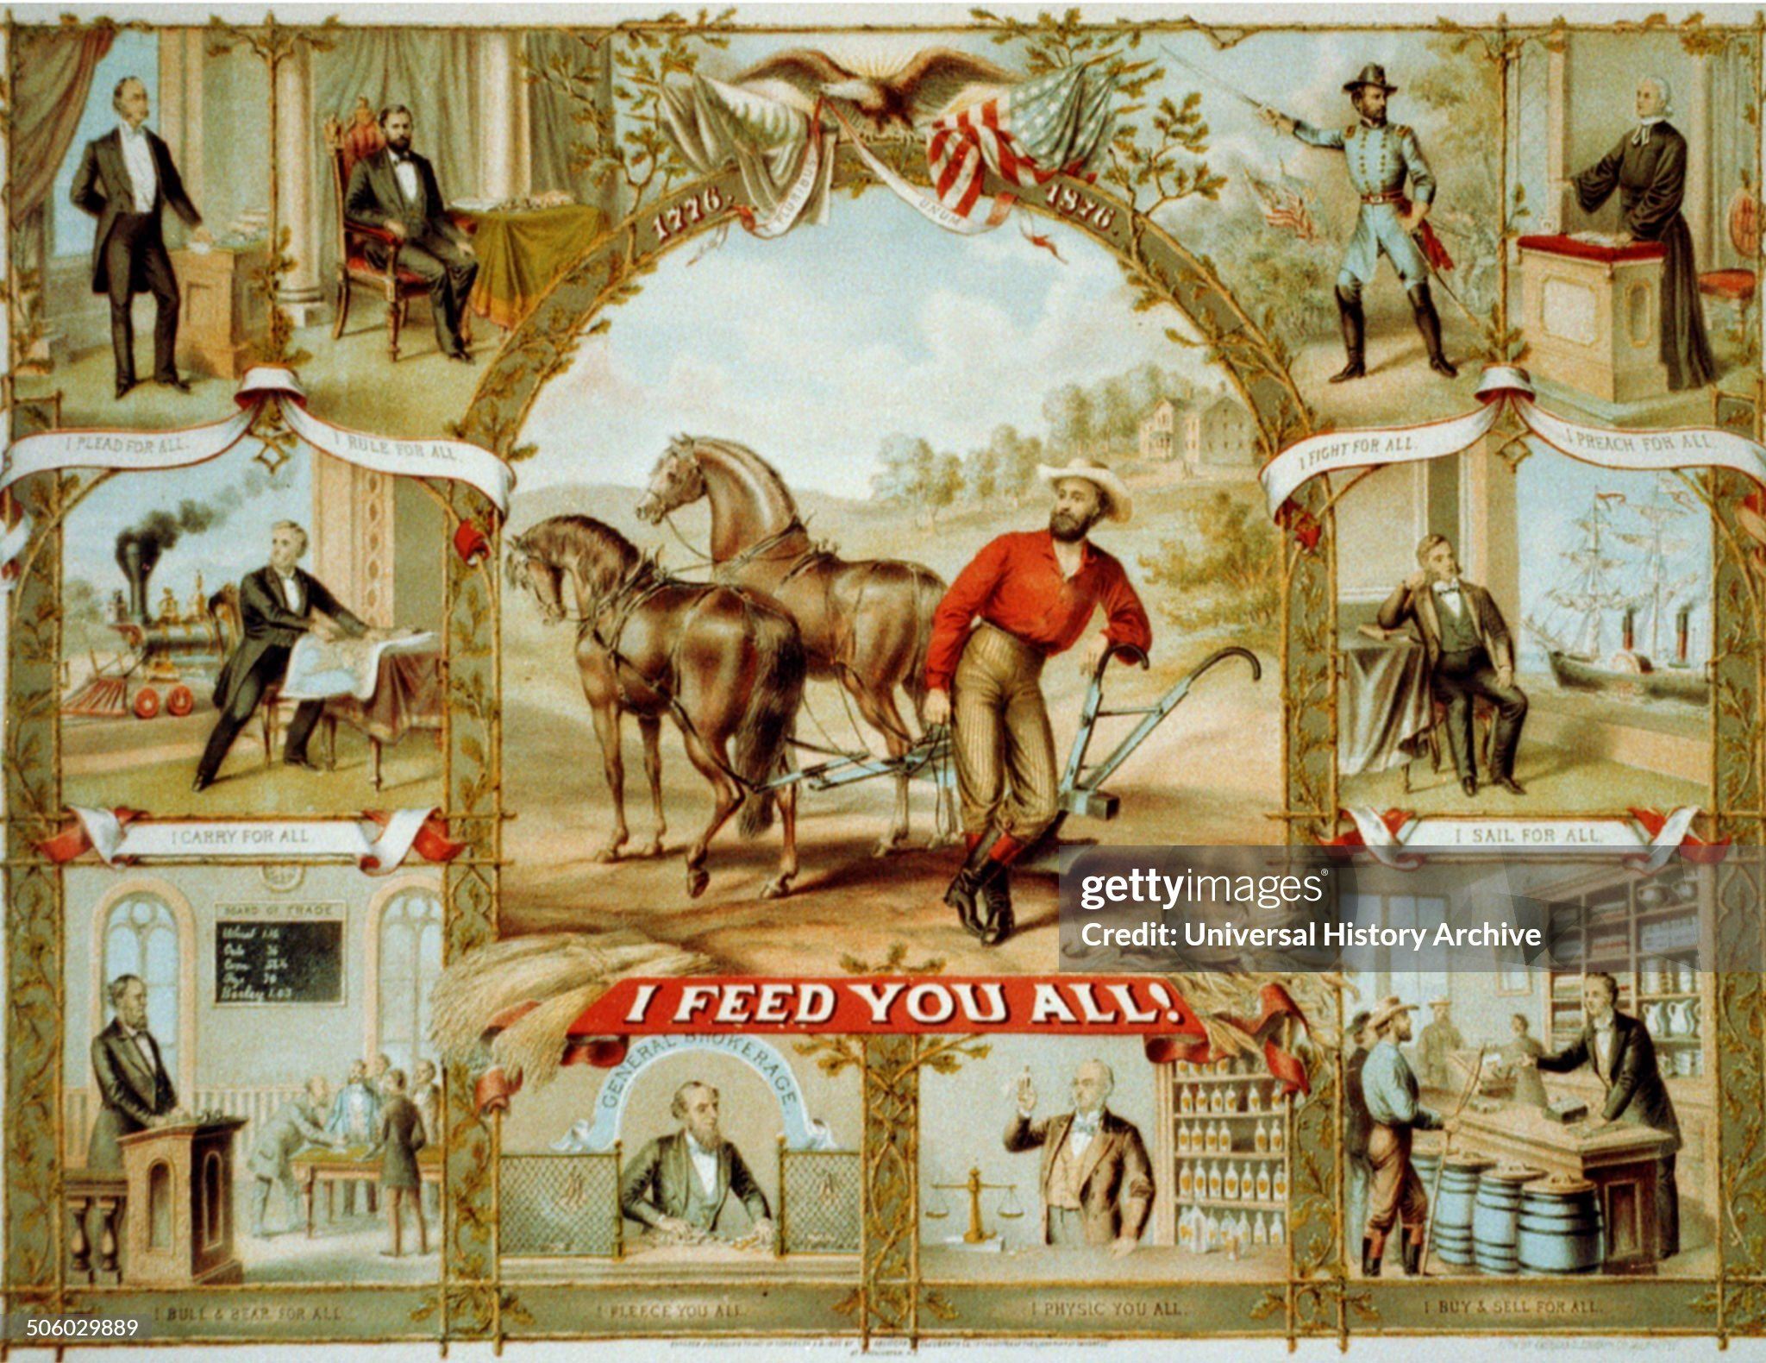
Granger cooperative movement 1870’s

Slide 42
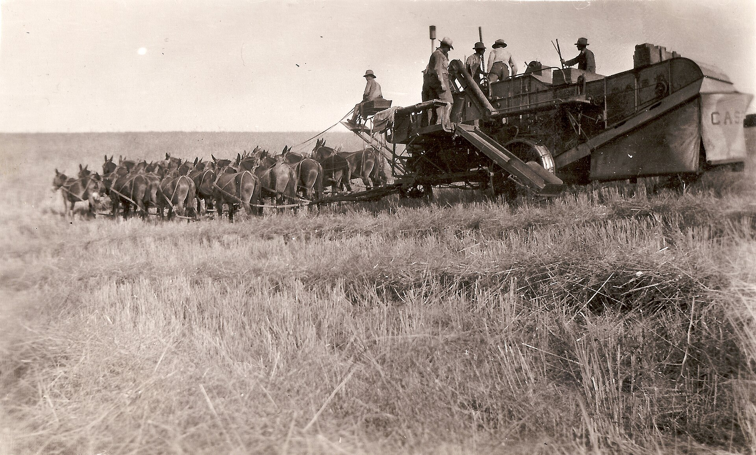
20 mule combine harvester 1890’s

Slide 43
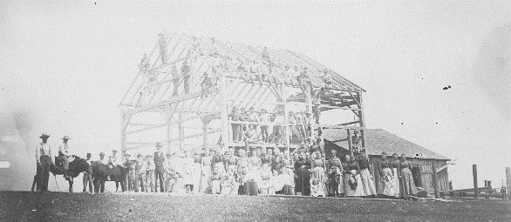
Close knit communities: Barn raising Indiana 1900

Slide 44
West 1890
West integrated into wider US economy and politicals
Ranches enclosed by barbed wire
Indians confined to reservations
Territories converted to States
West economy built on mass wheat production and ining
Seen as fulfilment of “Manifest Destiny”
…. independence, freedom & opportunity
….also violence, crime, corruption land degradation
Growing Constraints: falling prices, absence of rain, power of monopolies …….inexplicable.......conspiracy theories…..something must be done

Slide 45
Next talk: Rise of US industrial might and the struggles of industrial workers and farmers vs monopolies and capital

